Slide 1
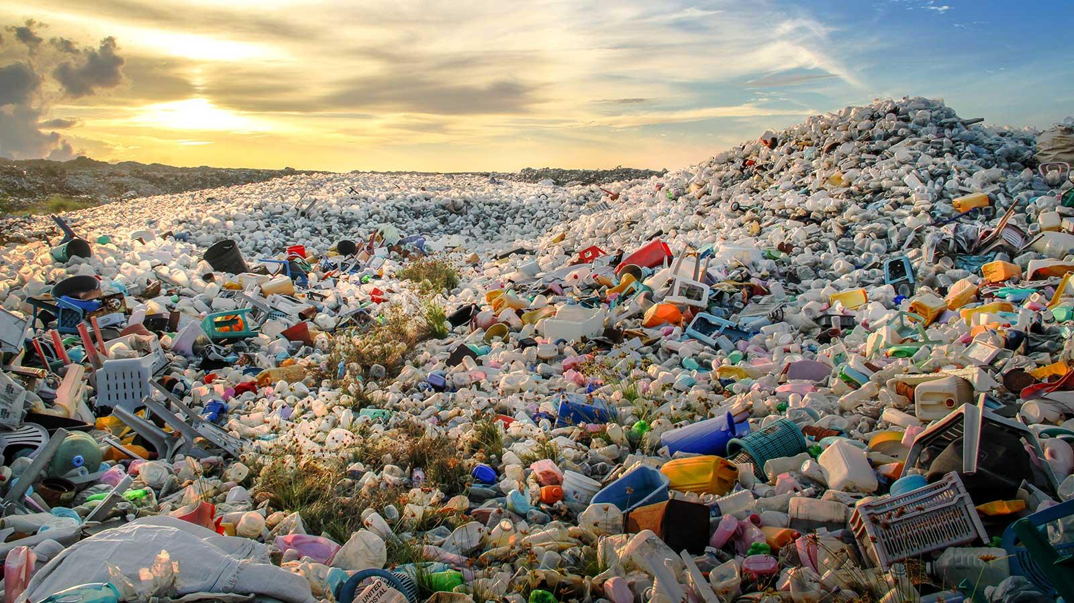

Solid Domestic-Waste (SDW) Classification using Image Processing and Machine Learning
Author: Daniel Otero Gómez
Advisors: Mauricio Toro Bermúdez and William Hoyos Morales

Slide 2




Team Presentation
Daniel Otero Gómez
Mauricio
Toro
William Hoyos

Slide 3
Agenda
Introduction
General and Specific Objectives
Developments and Experimentation
Results
Mathematical Background
References

Slide 4
Introduction
Households
Malls
SDW
Everyday use items
Universities
Offices

Slide 5
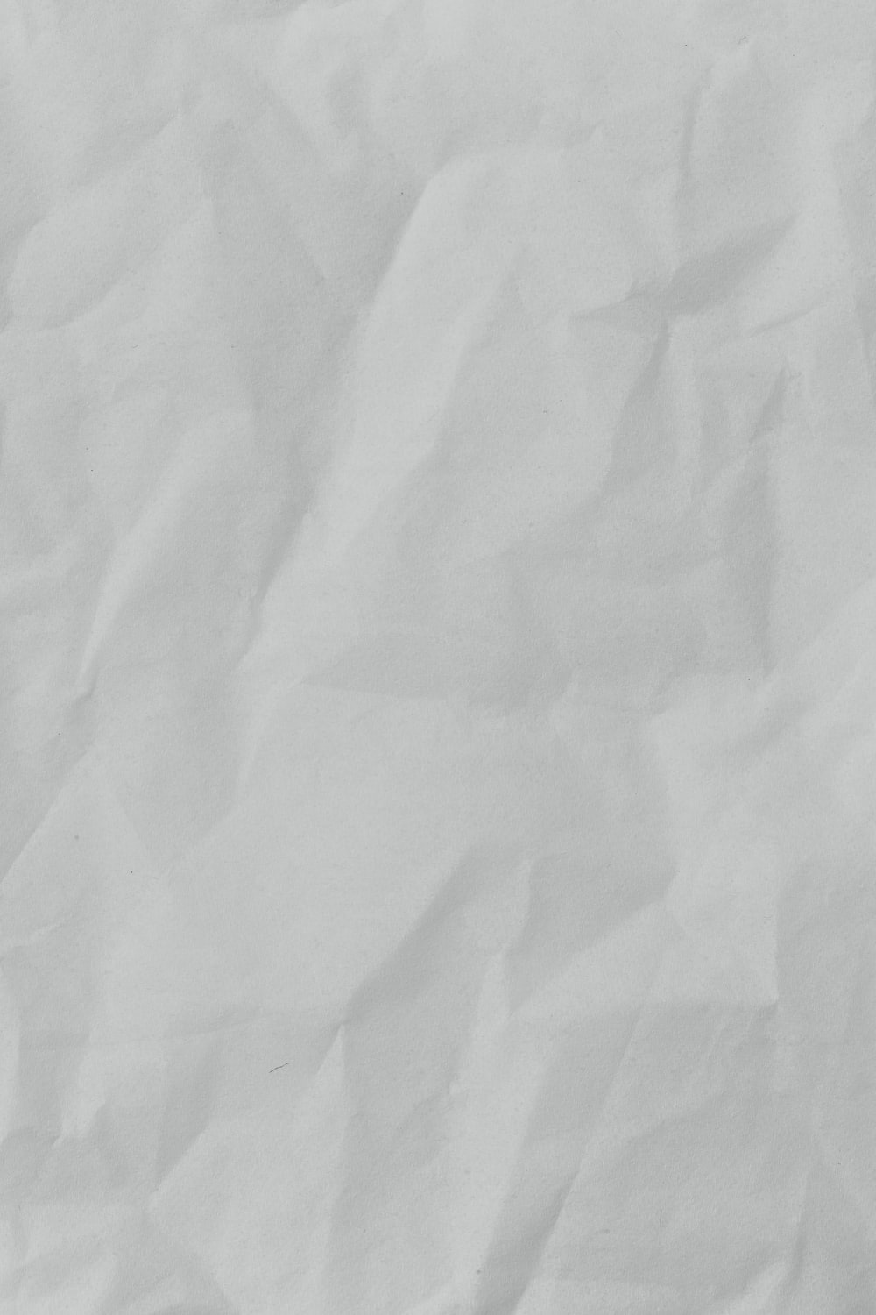
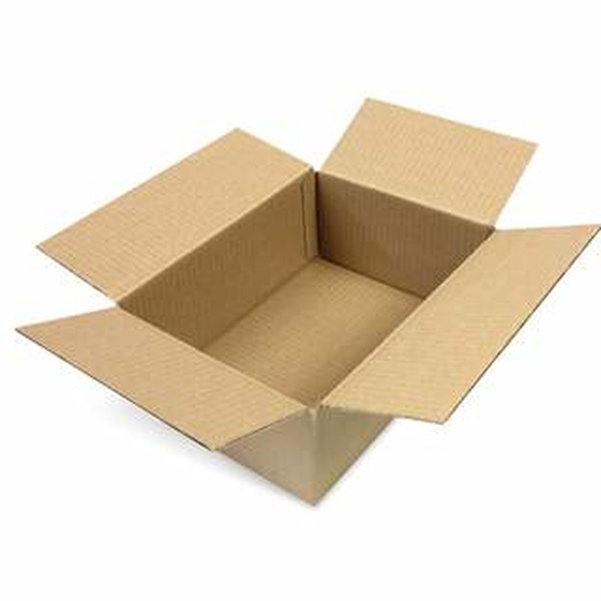
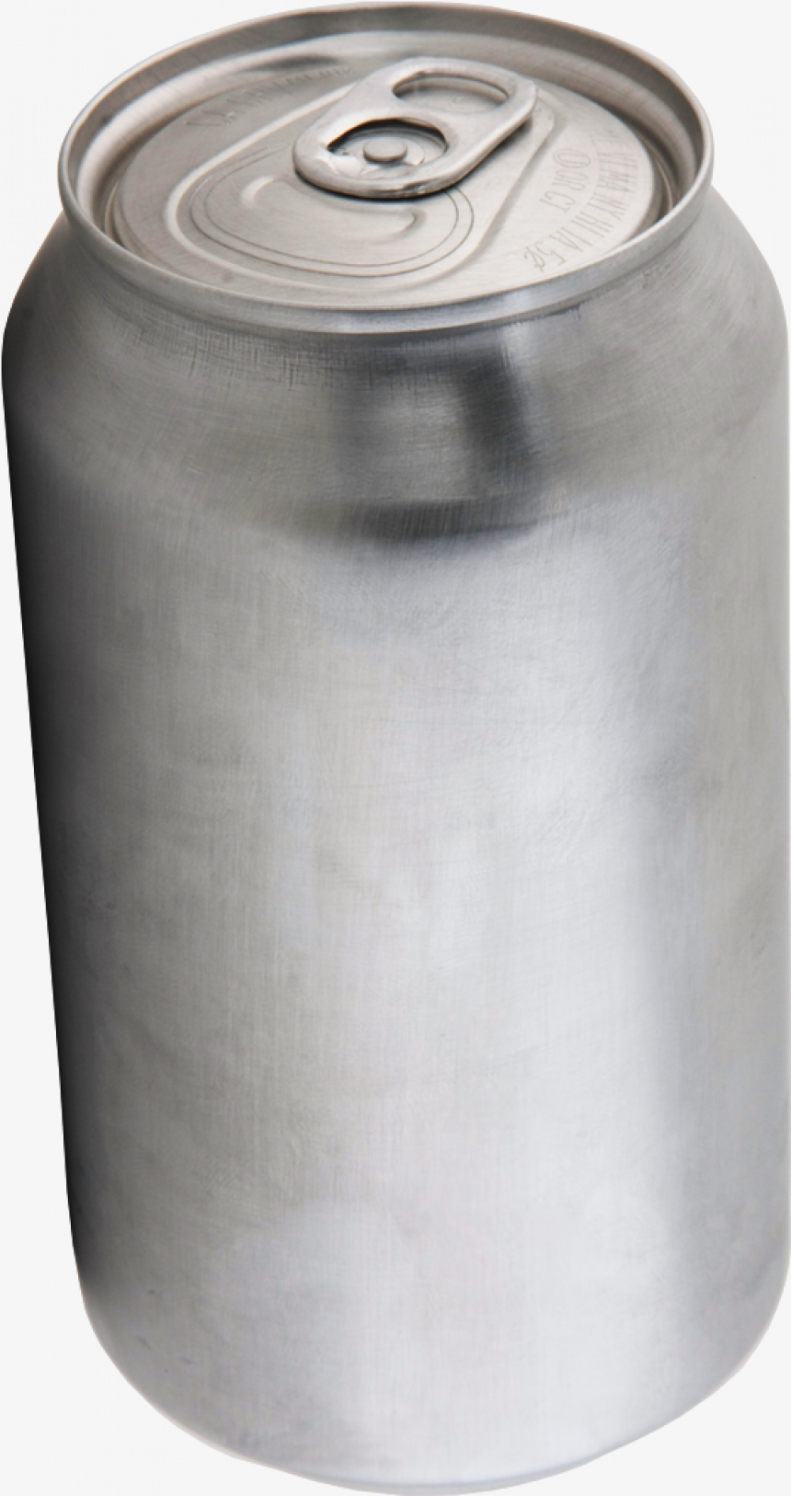
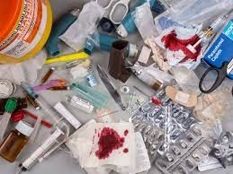
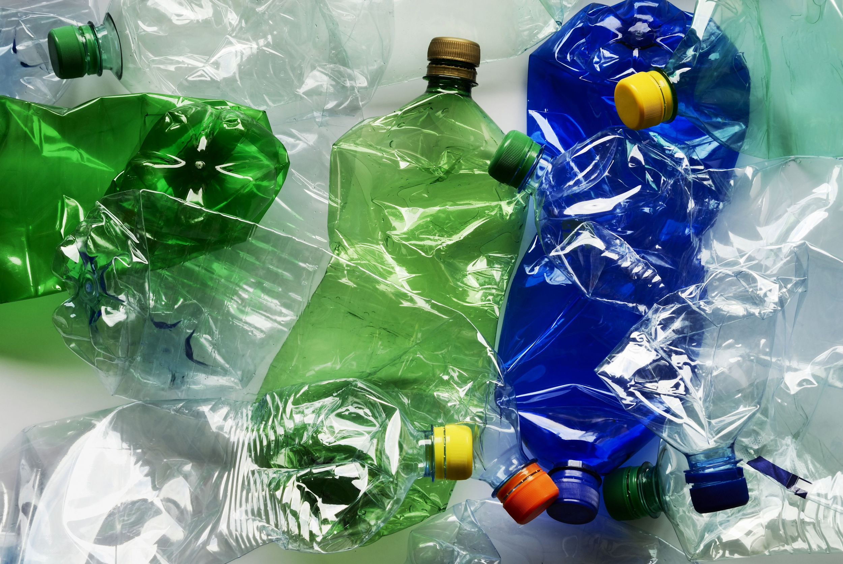
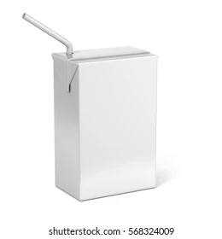
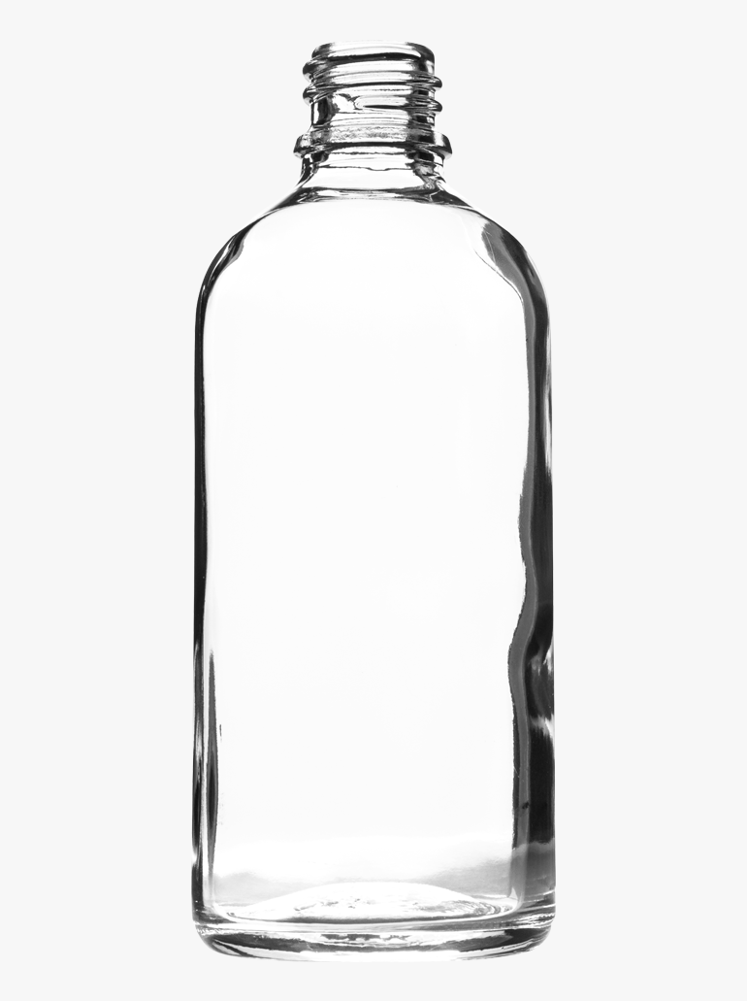
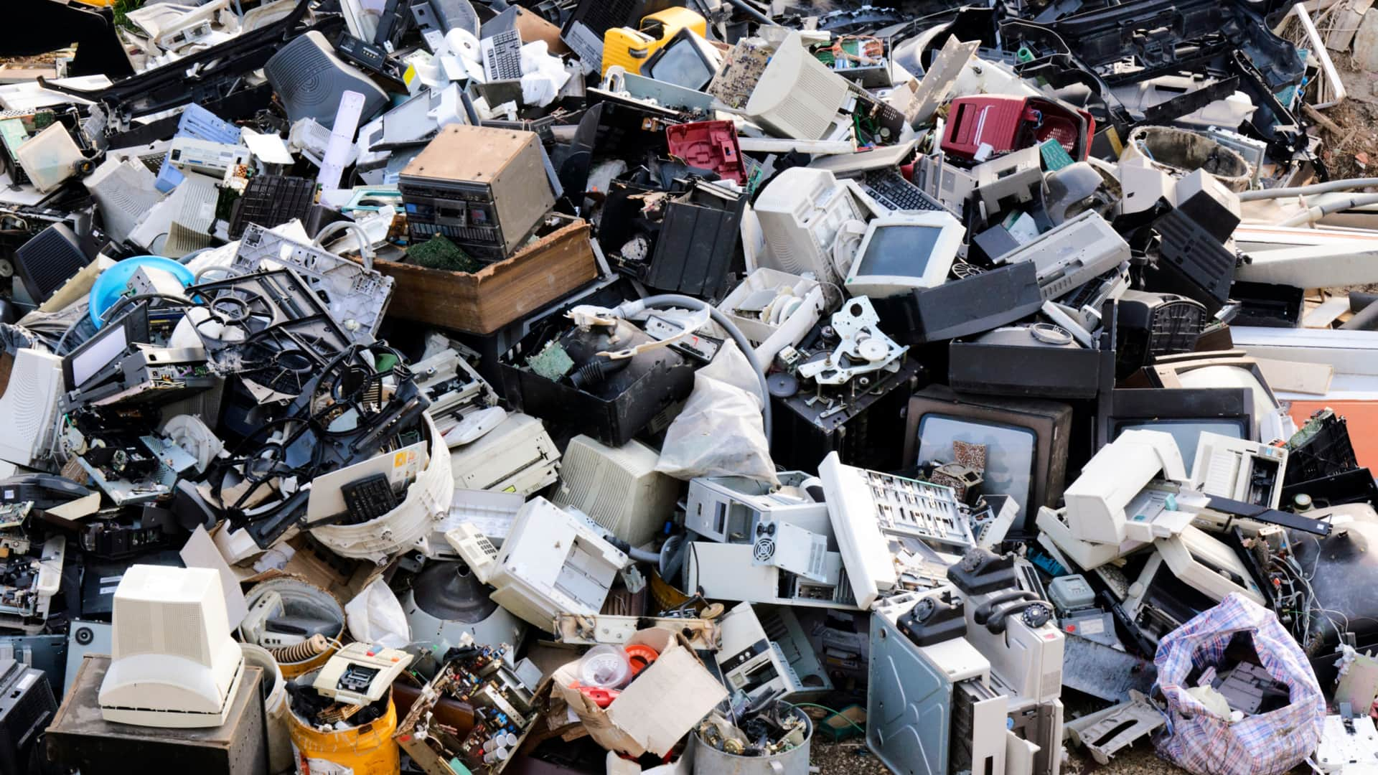
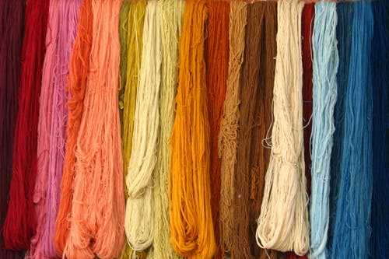
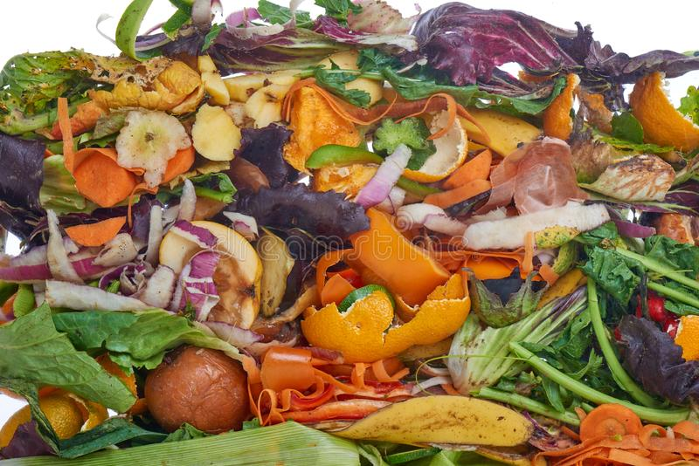
Introduction
Recyclable Organic
Recyclable Inorganic
Non-Recyclable
Images
Paper
Cardboard
Plastic
Metal
Sanitary
Textiles
Tetra Pak Containers
Glass
Electronics
Food waste

Slide 6
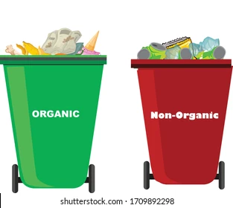
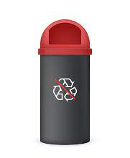
General Objective
General Objective
To design a model to classify solid domestic waste images using image processing and machine learning.

Slide 7
Specific Objective
To explain the methods, techniques and algorithms included in the model.
To develop a processing pipeline for SDW images.
Specific Objectives
To apply a machine learning algorithm for SDW image classification.
To evaluate the classification accuracy of the implemented model.

Slide 8
Developments and Experimentation
Exploratory Phase
Pipeline Development:
Image preprocessing.
Dataset:
Value rescaling
Edge Detection
Cardboard boxes
Dimension Reduction.
810 images
Plastic Bottles
PCA
PCA 80%
NMF
Hyperparameter tuning.
Learning Curve.
Accuracy
10-Fold Cross Validation.
AUC ROC
File management and experiment register.

Slide 9
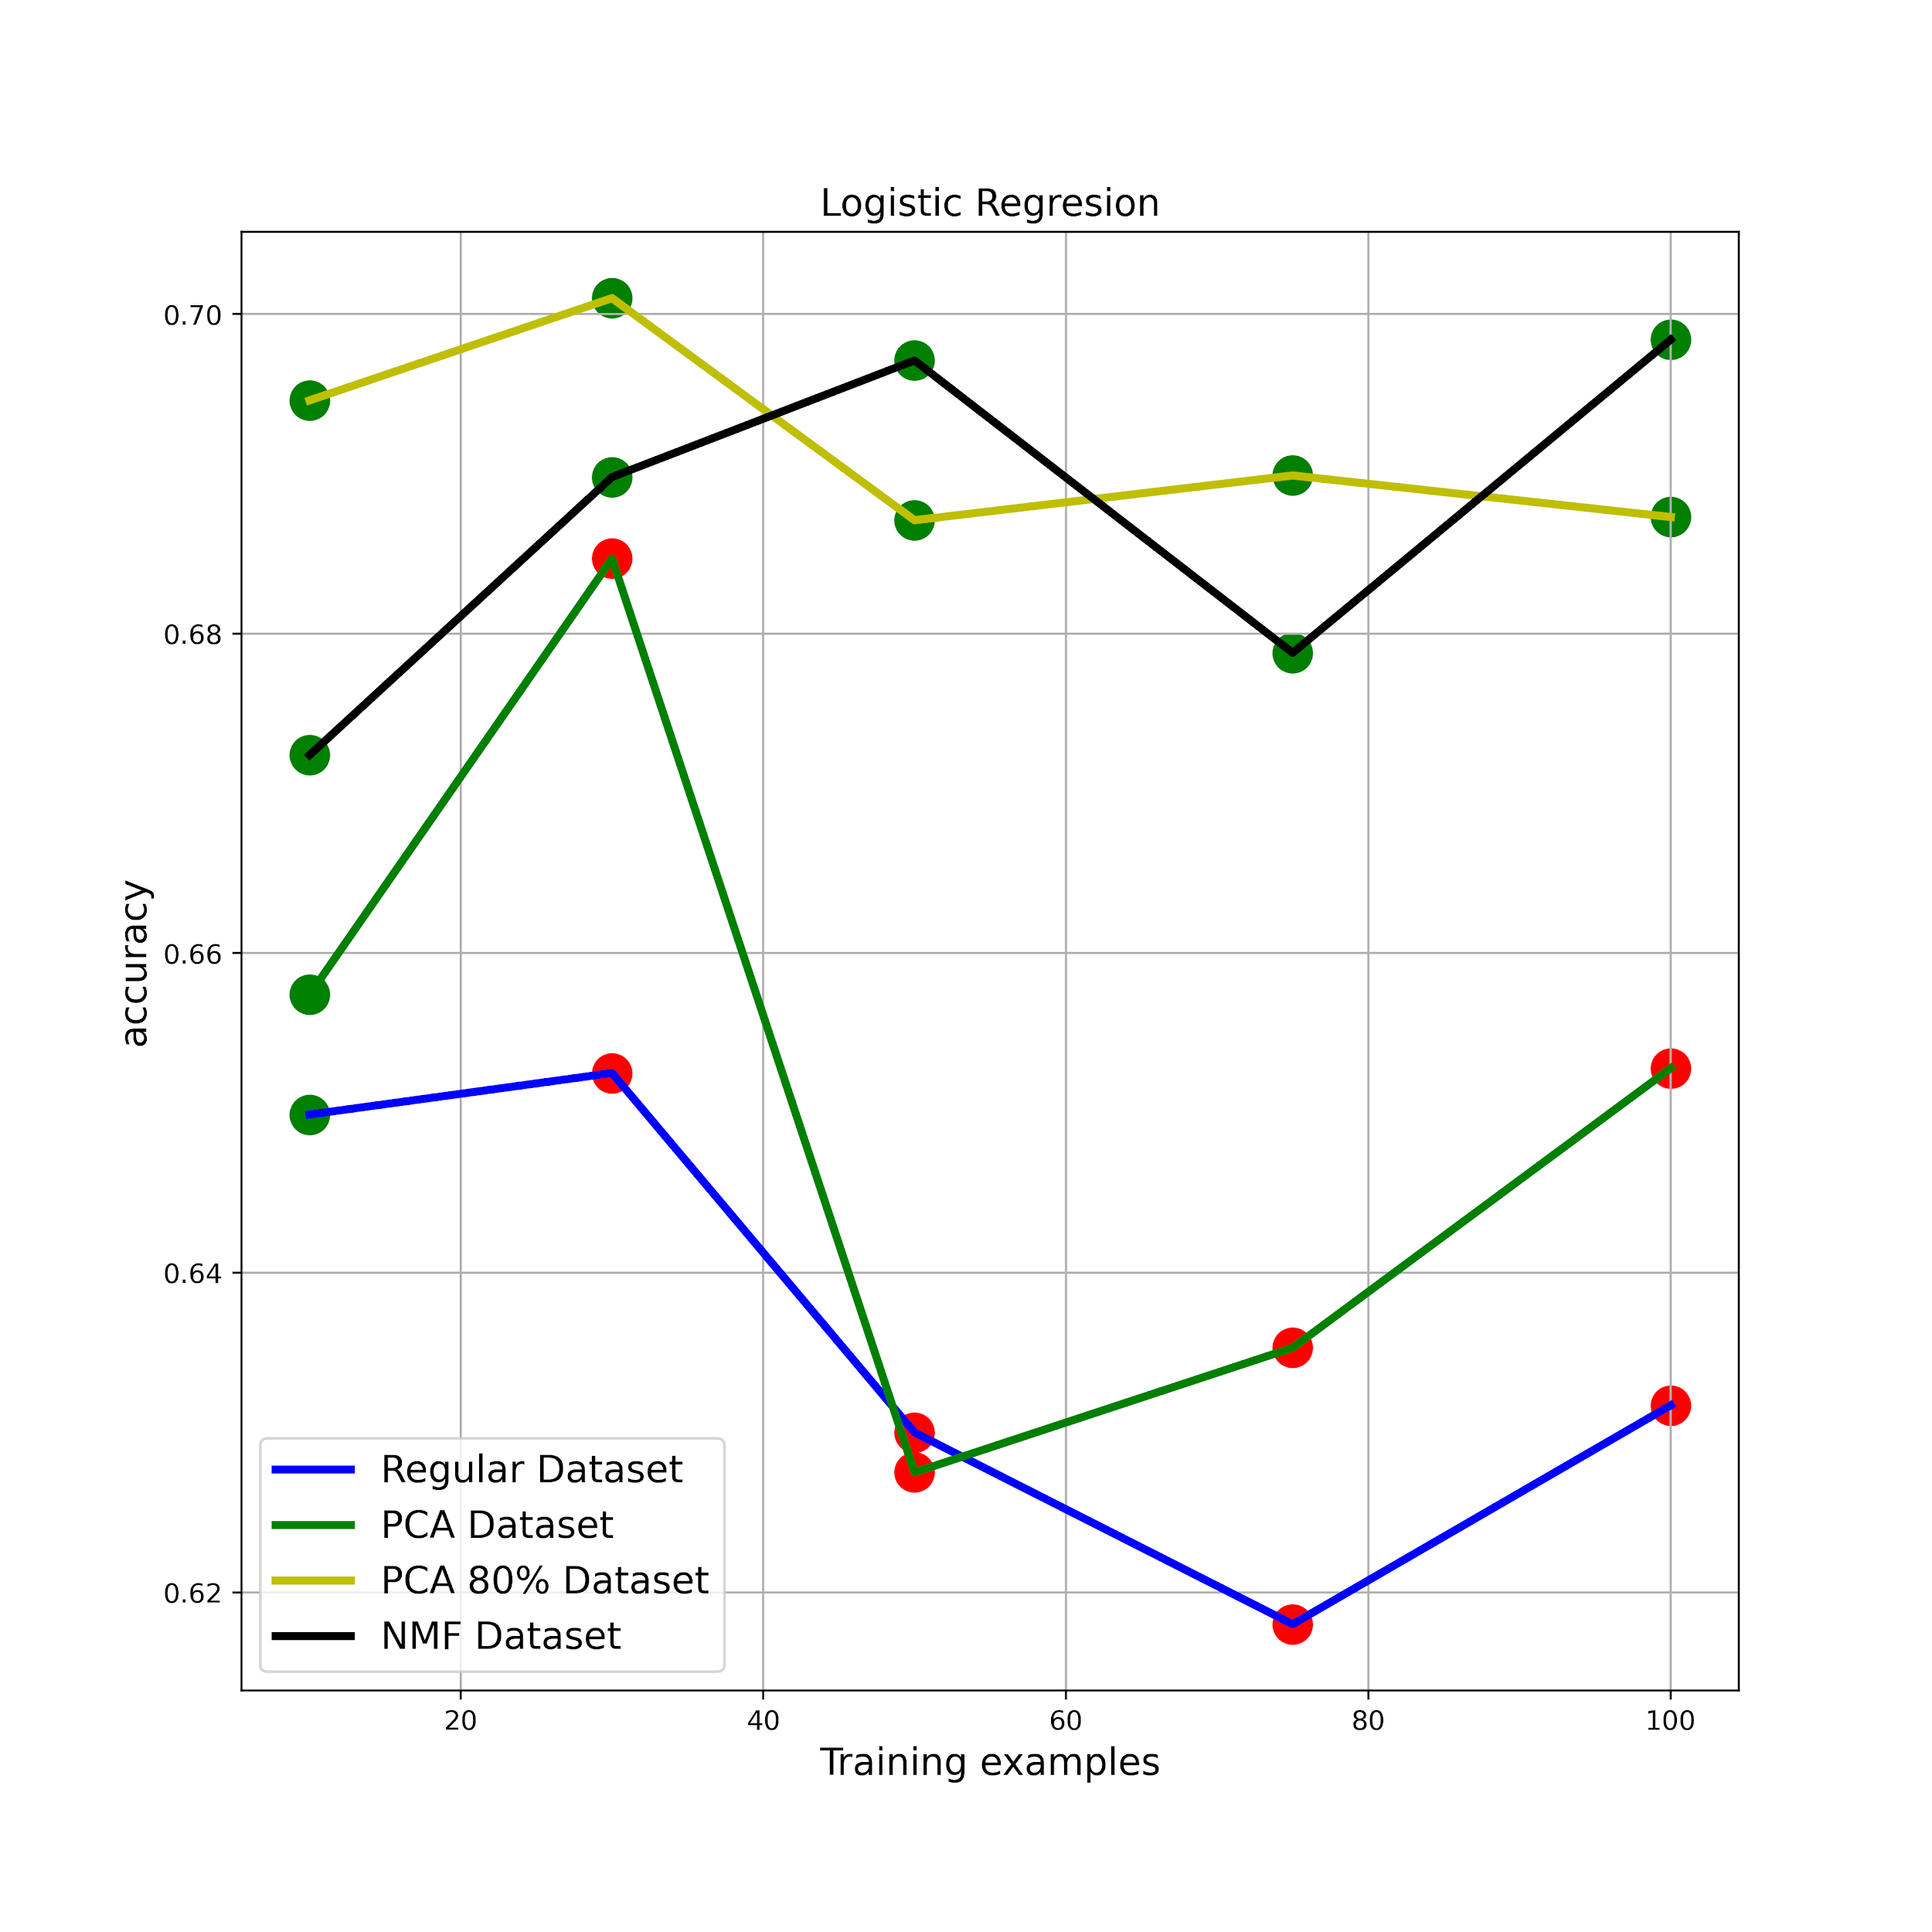
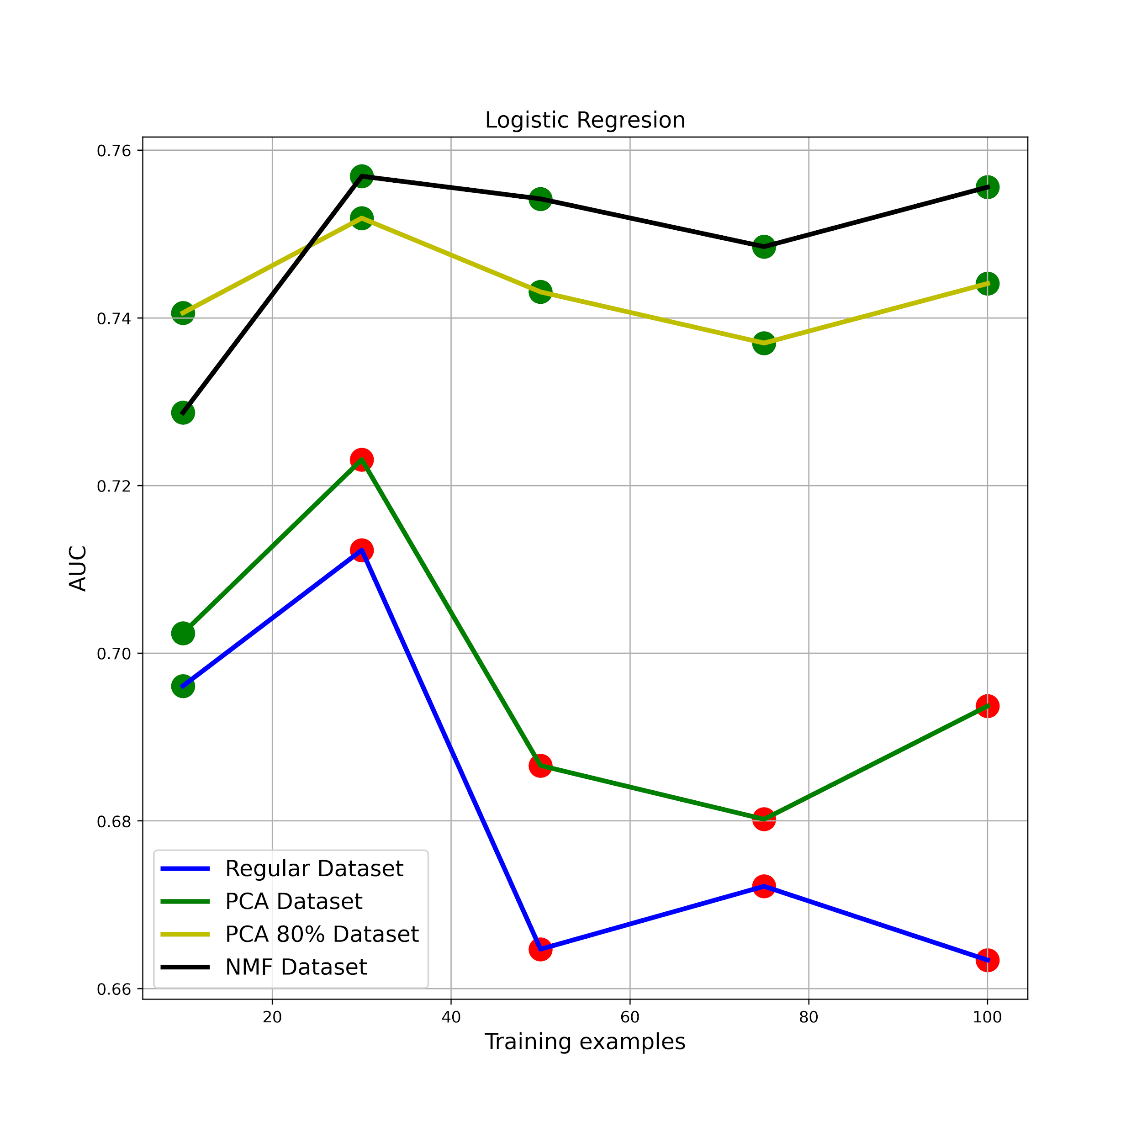
Results
Logistic Regression

Slide 10
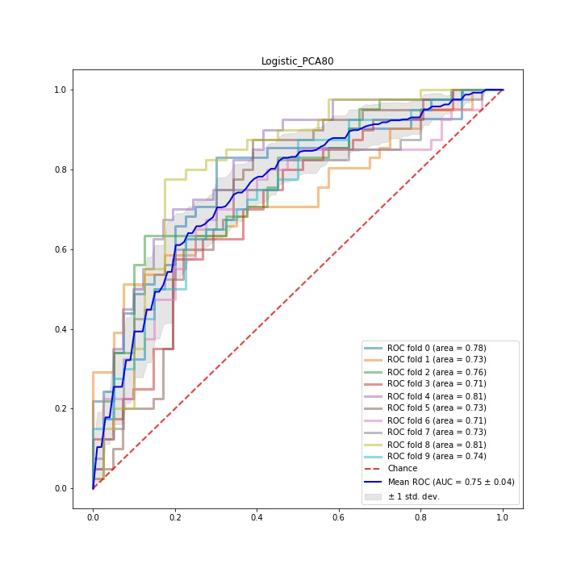
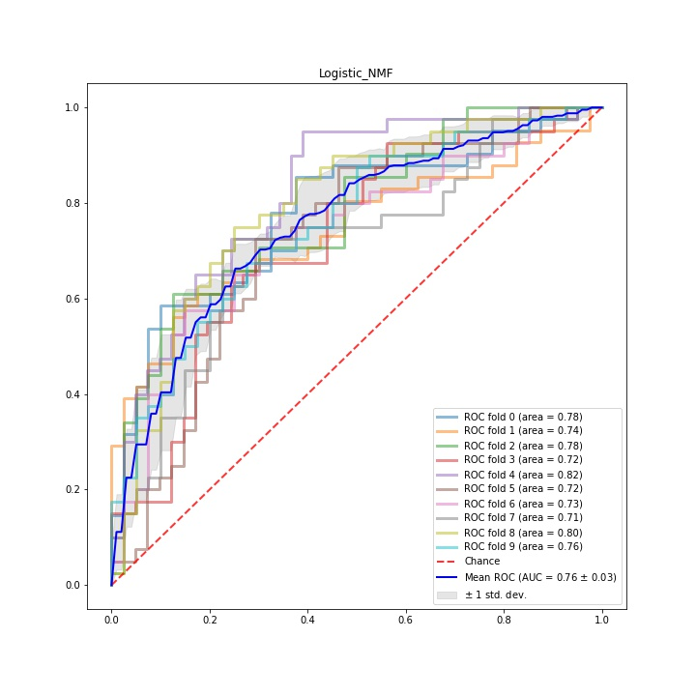
Results
Logistic Regresion

Slide 11
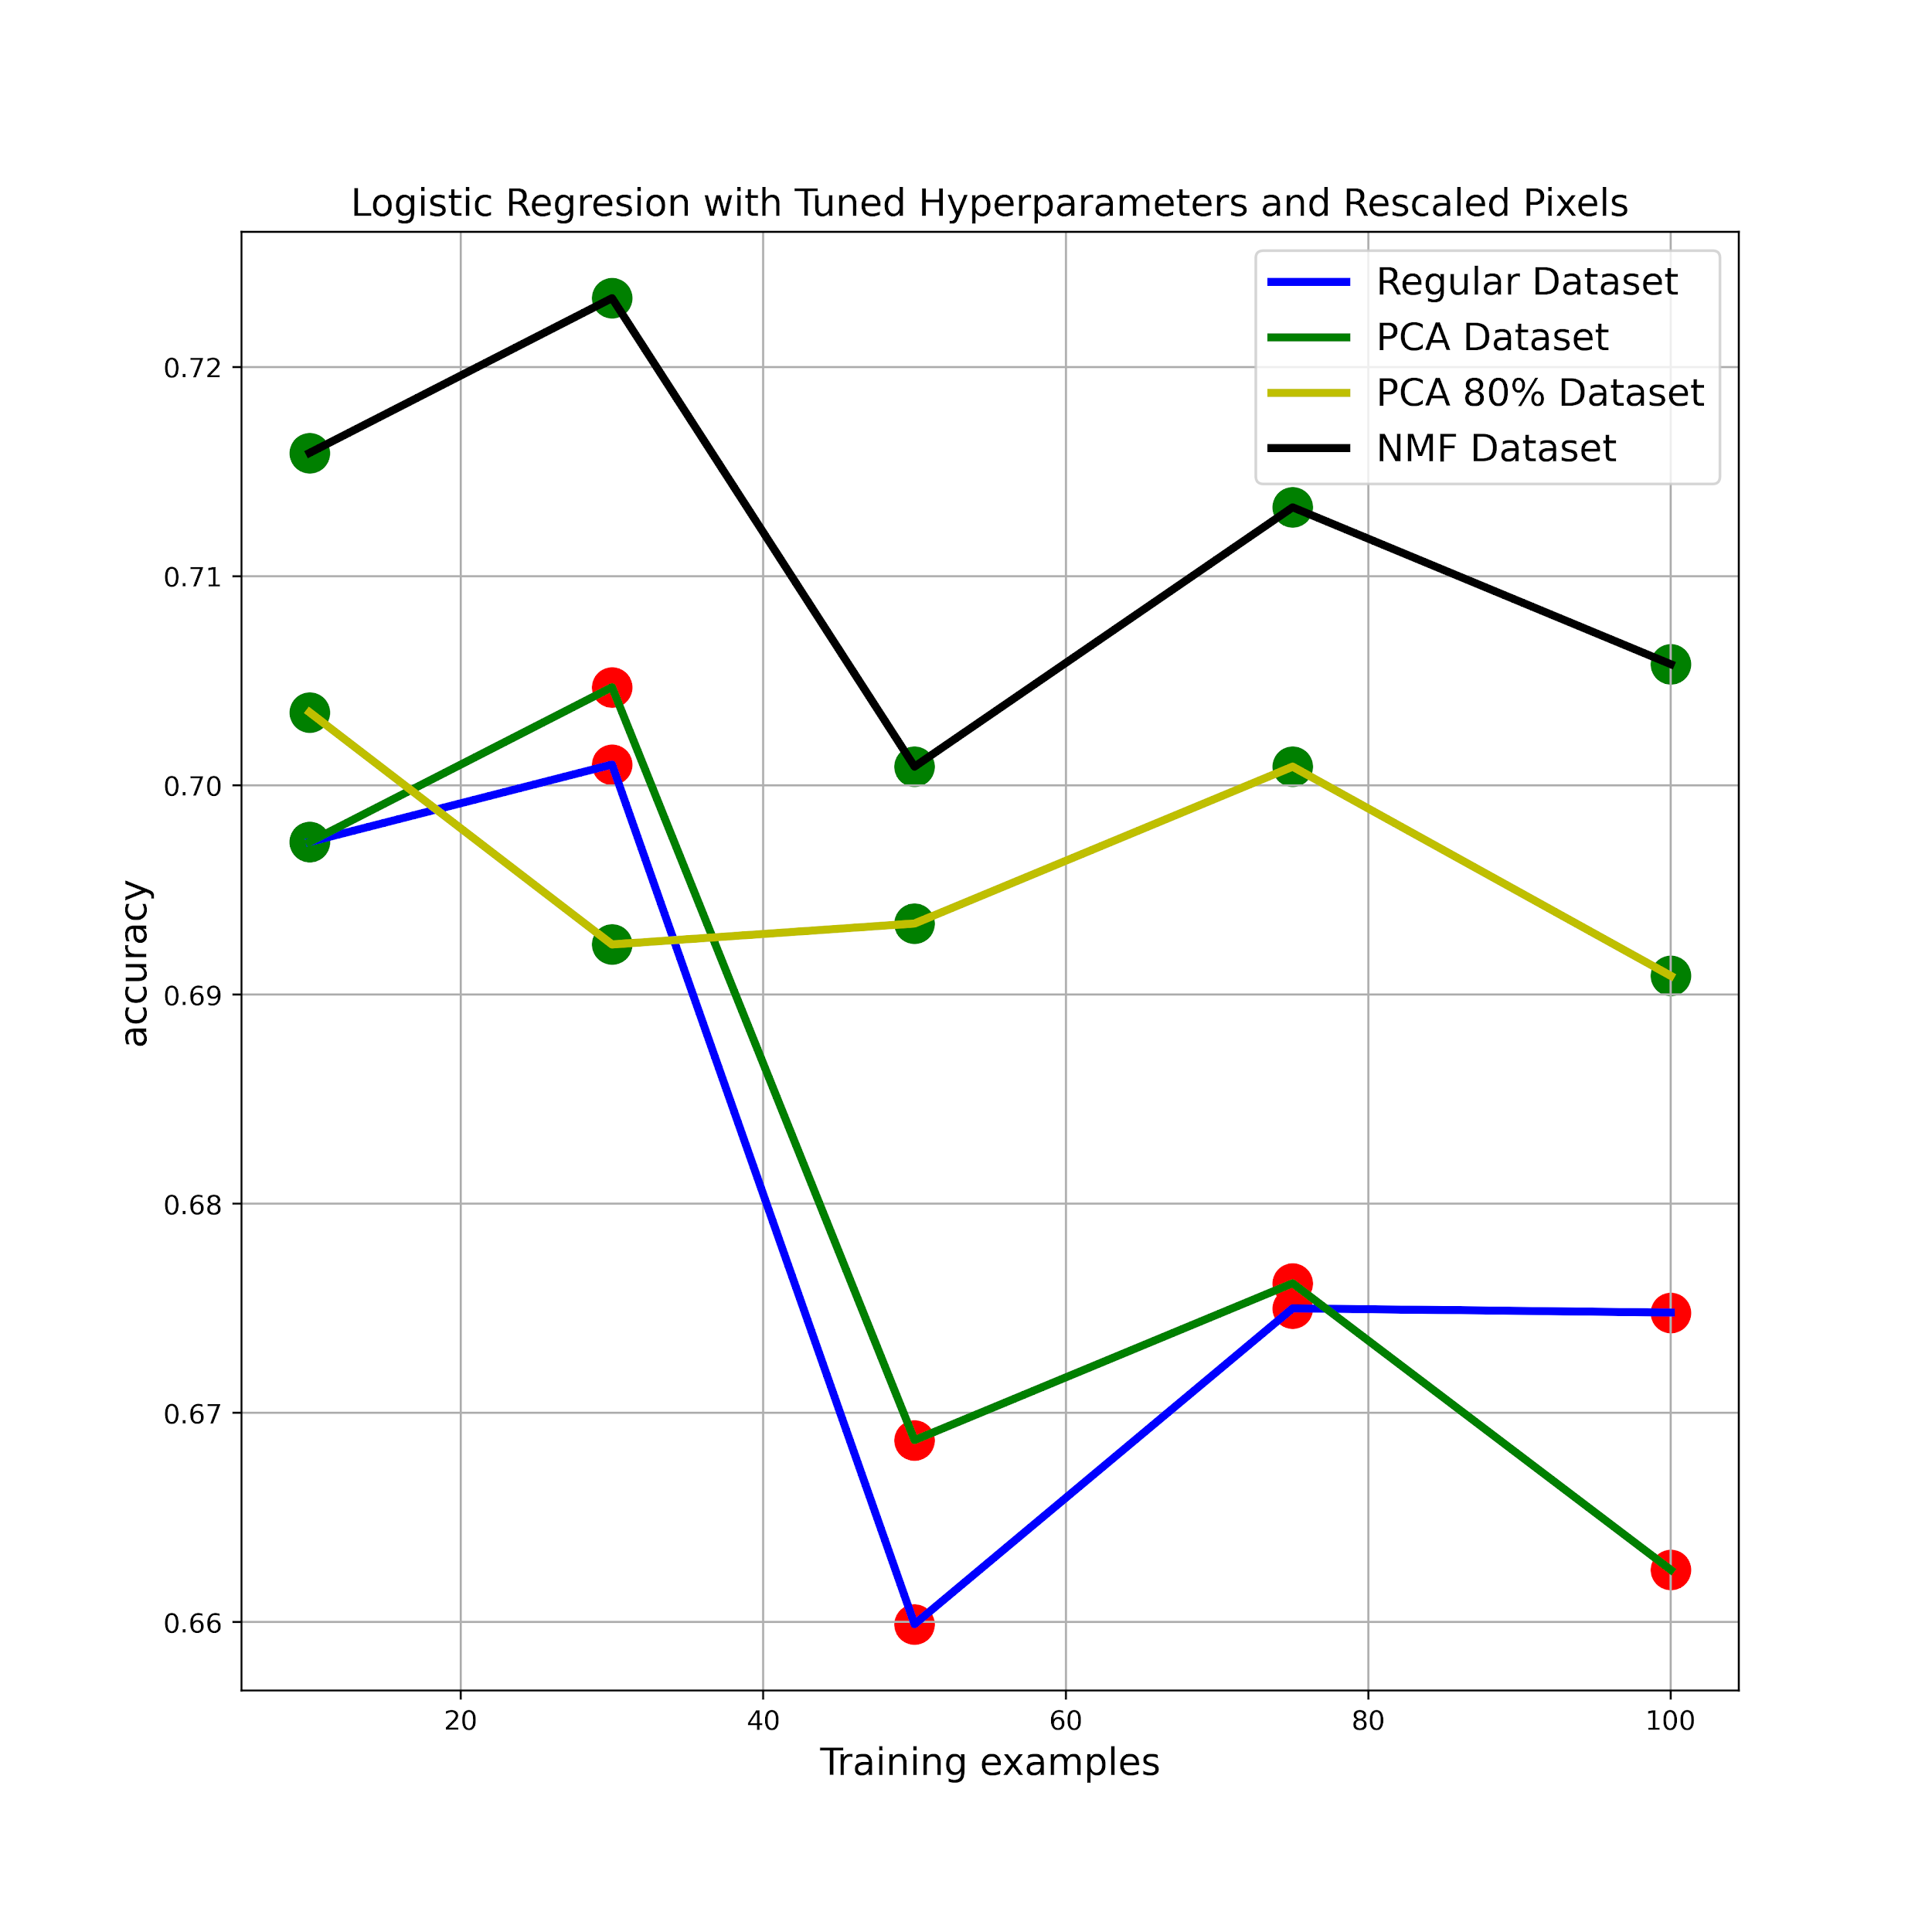
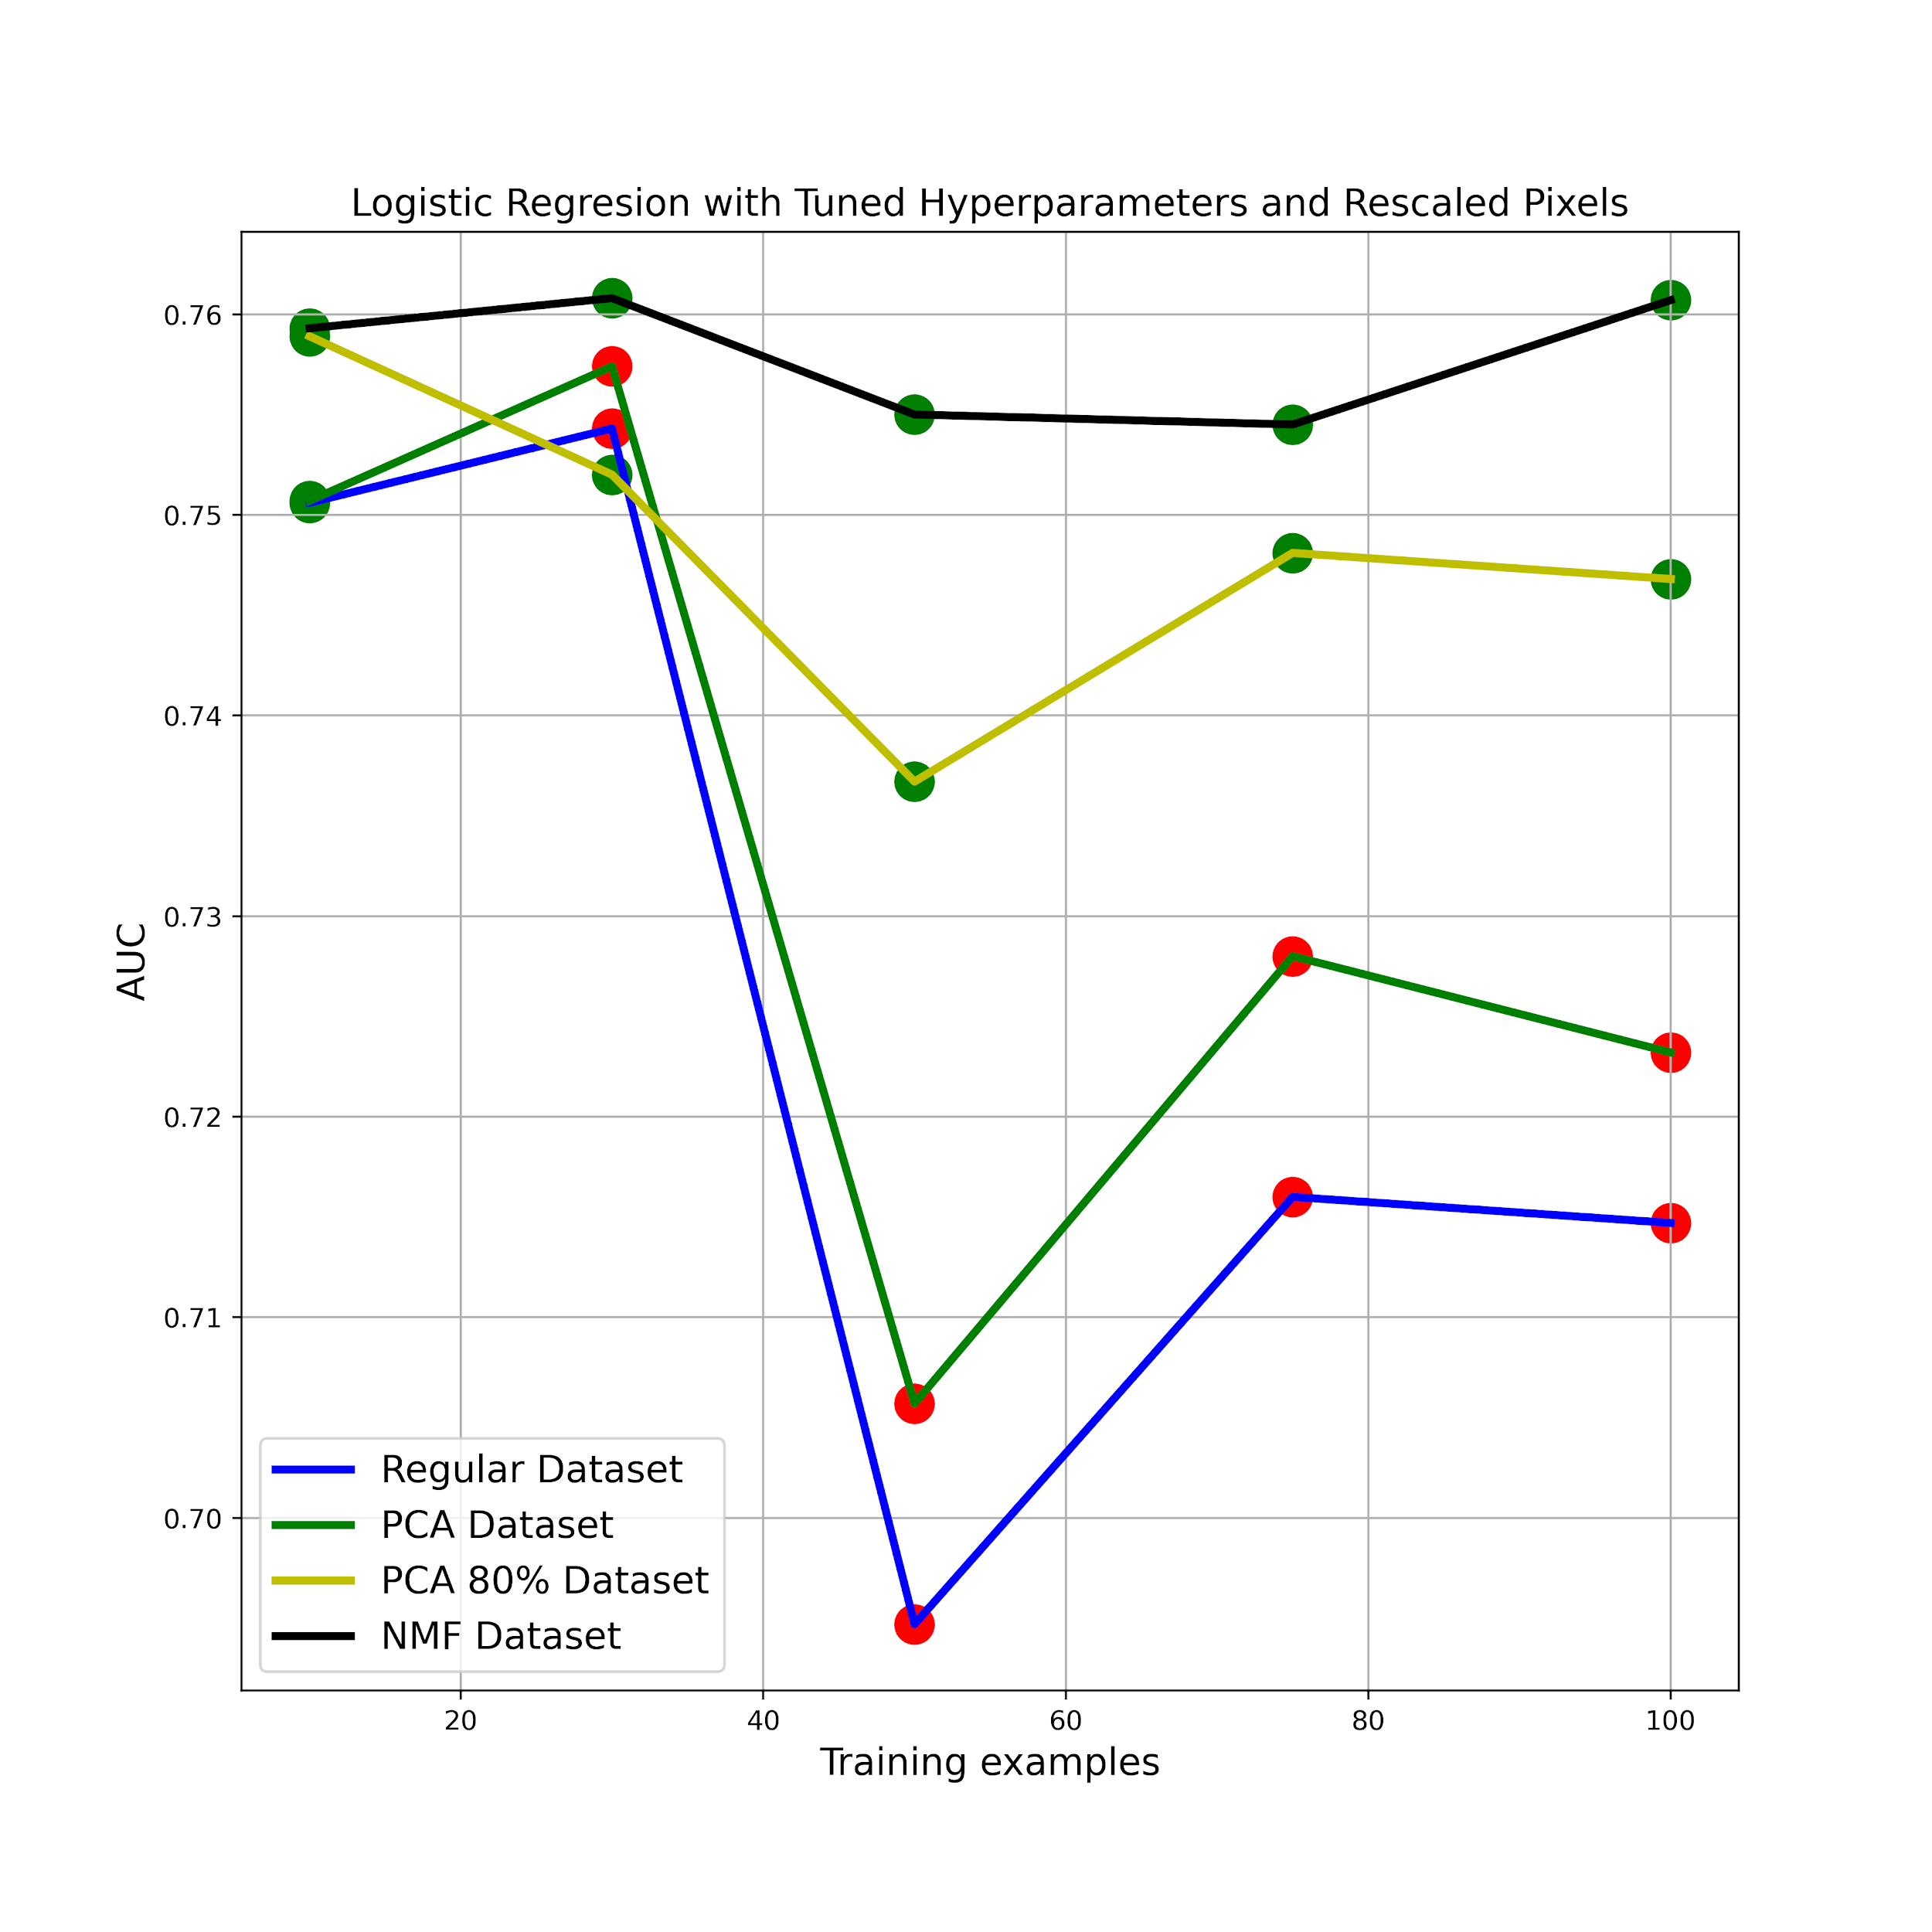
Results
Logistic Regression

Slide 12
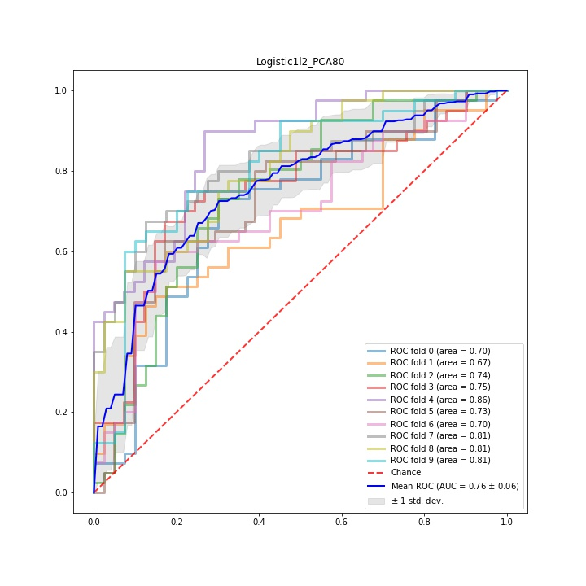
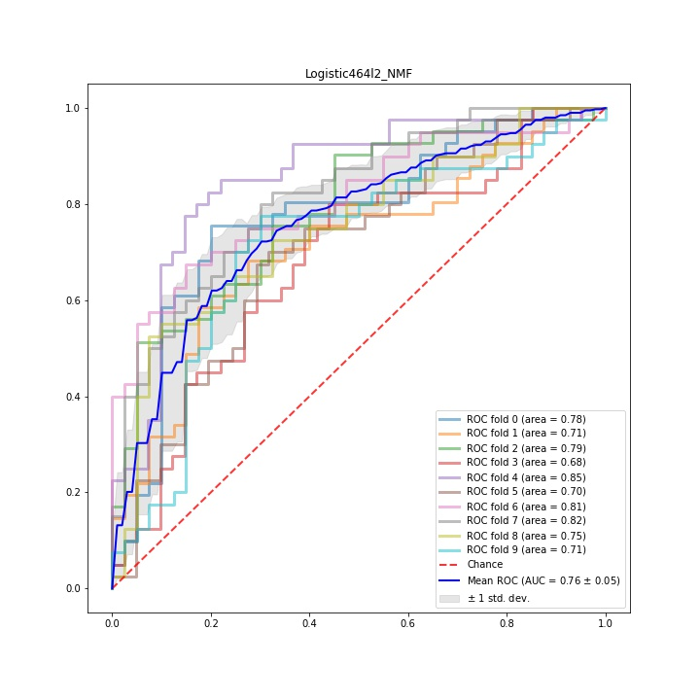
Results
Logistic Regression

Slide 13
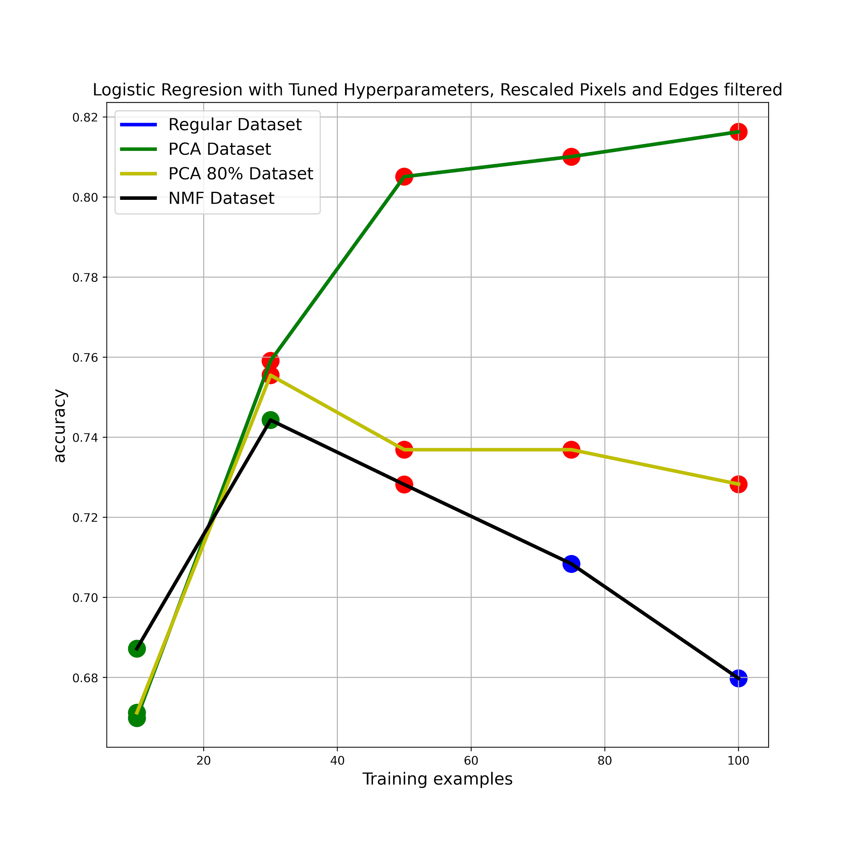
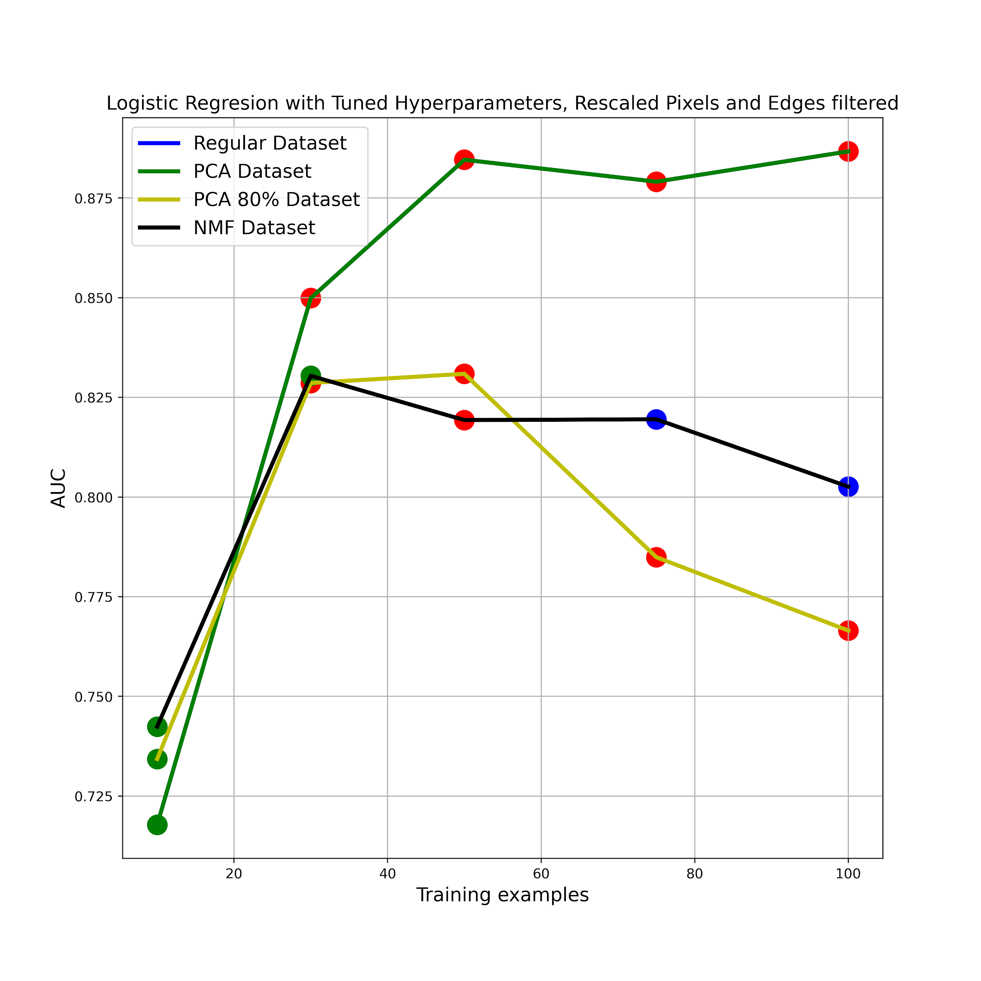
Results
Logistic Regression

Slide 14
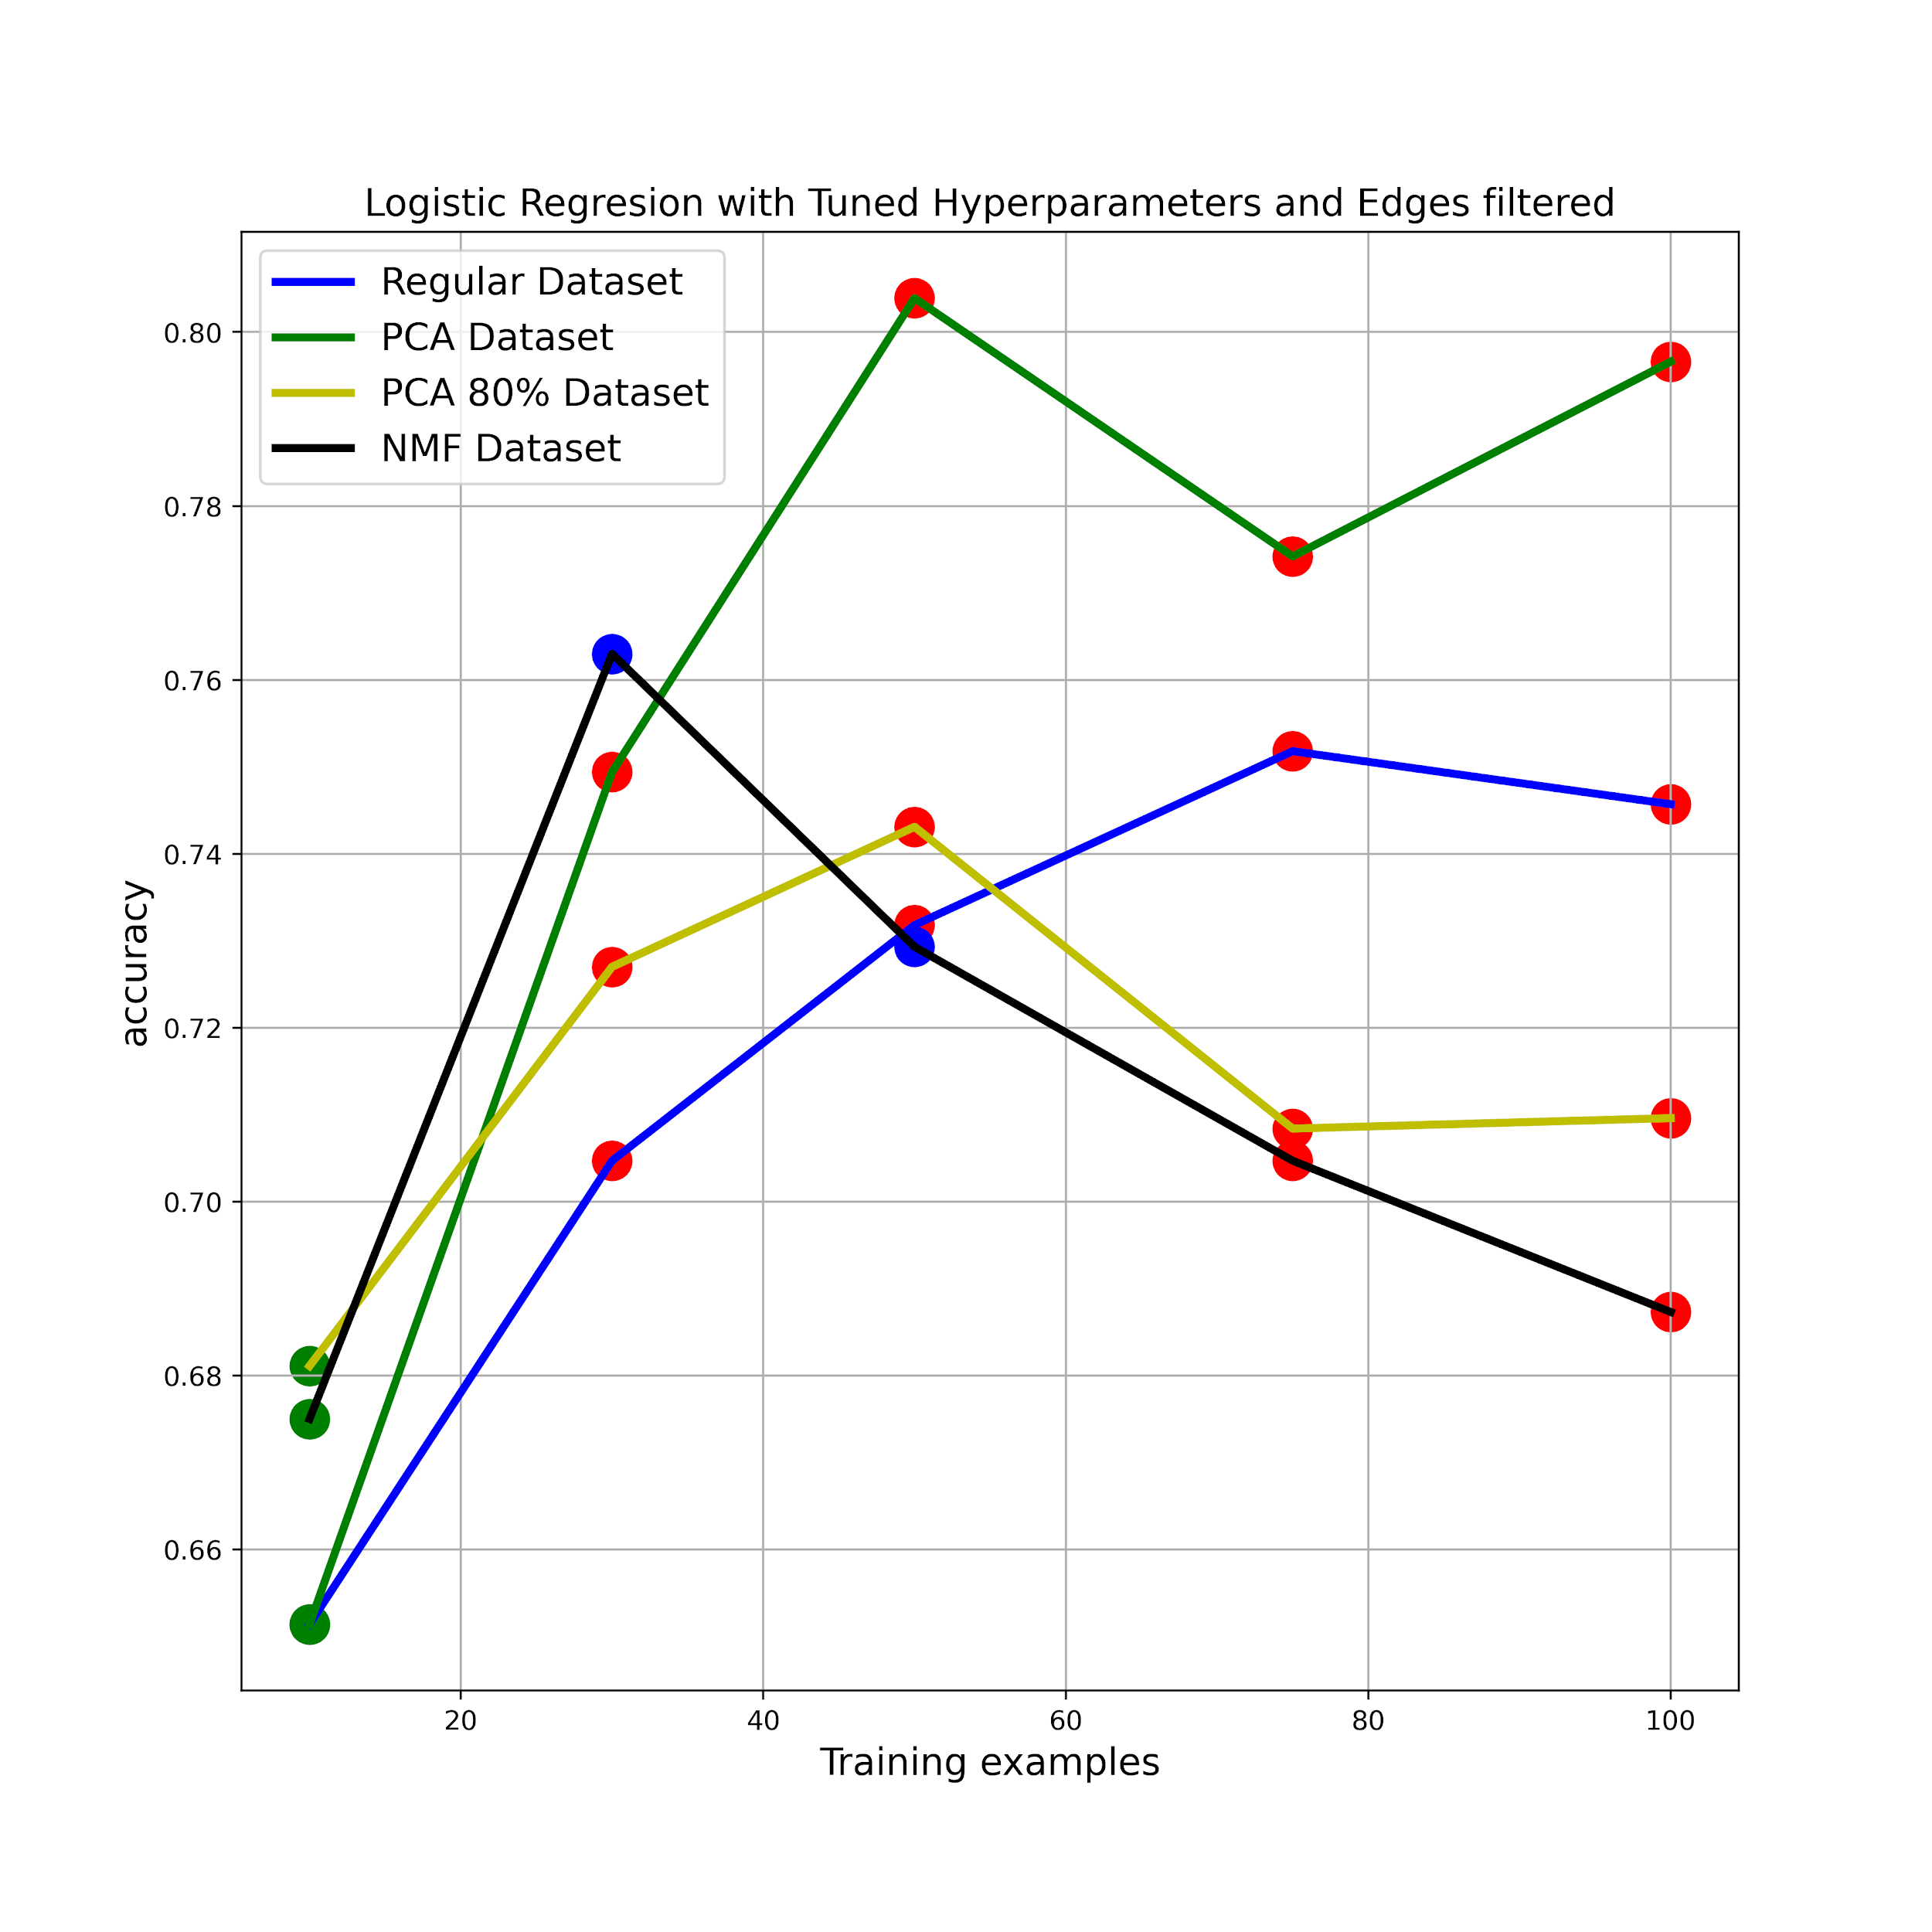
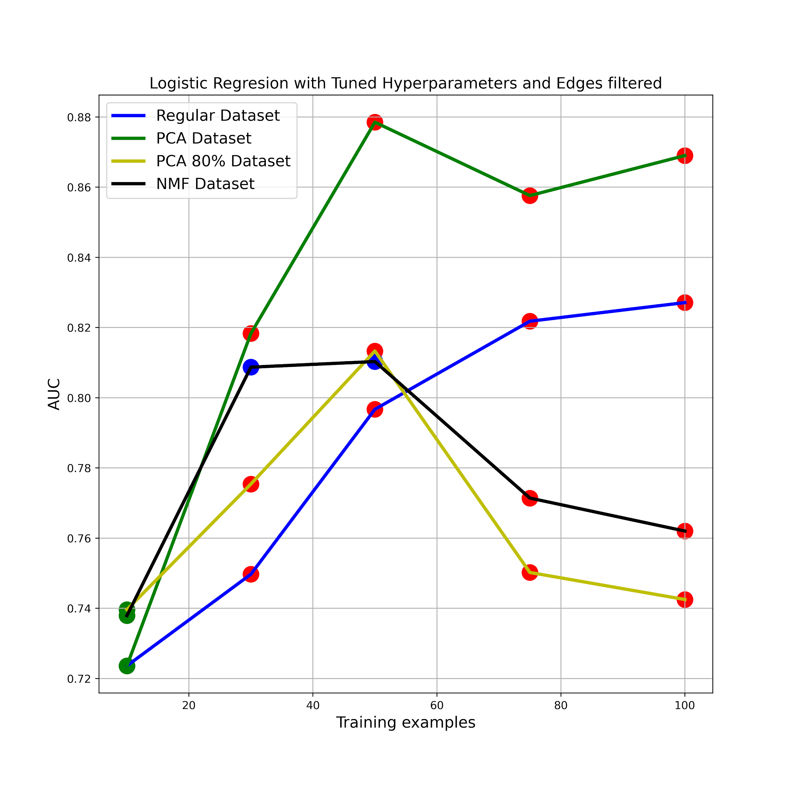
Results
Logistic Regression

Slide 15
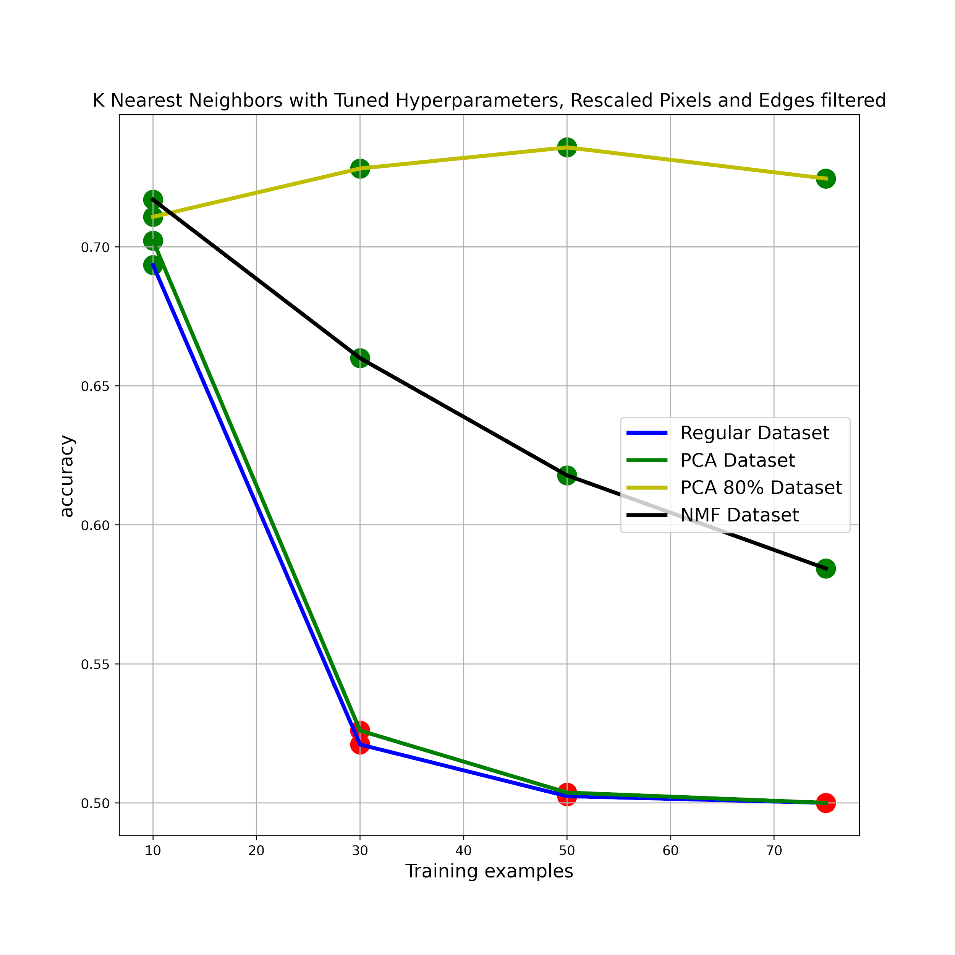
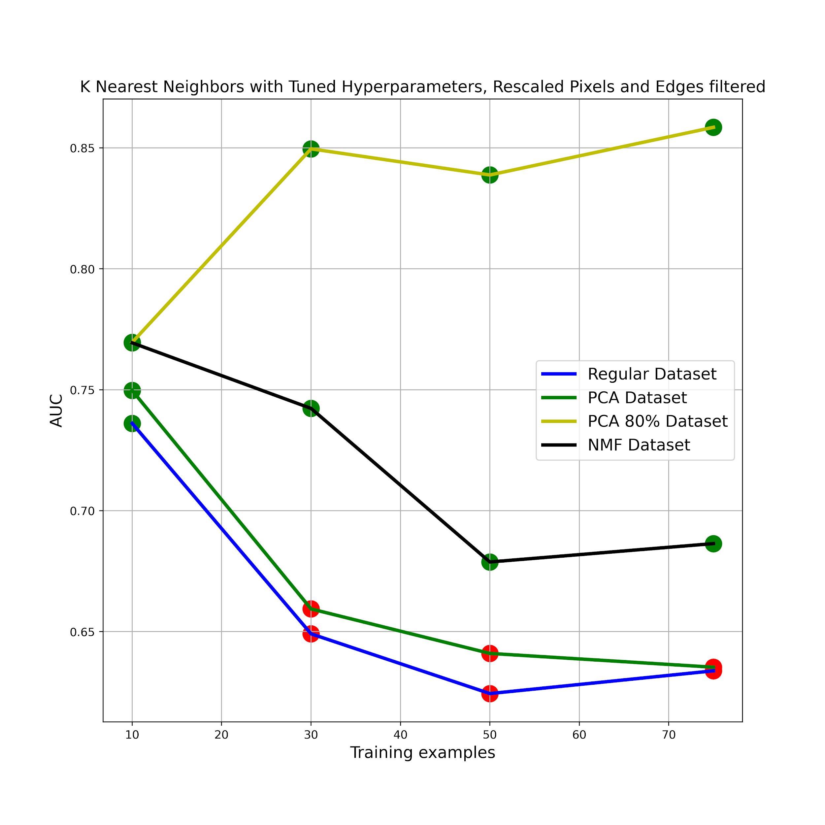
Results
K Nearest Neighbors

Slide 16
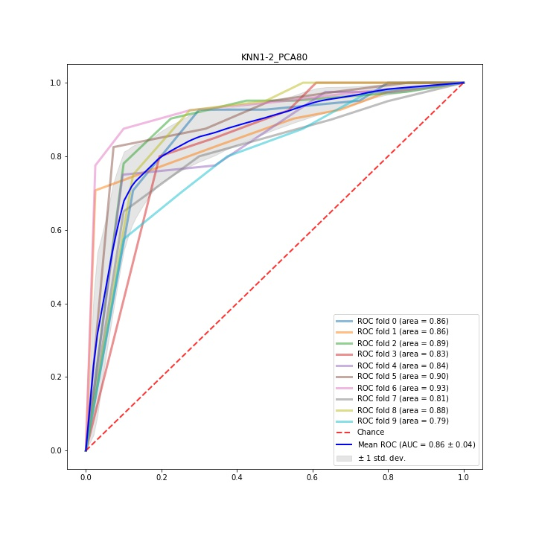
Results
K Nearest Neighbors

Slide 17
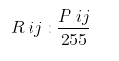
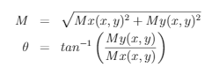
Mathematical Background
Exploratory Phase
Value Rescaling:
Edge Detection: Canny Algorithm

Slide 18
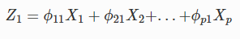
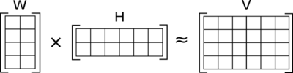
Mathematical Background
Dimension Reduction
Principal Components Analysis (PCA):
Non-negative Matrix Factorization (NMF):

Slide 19
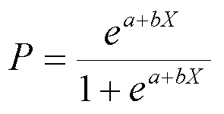
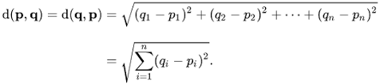
Mathematical Background
Models
Logistic Regression:
K Nearest Neighbors (KNN):

Slide 20
References
Aguilar-Virgen, Quetzalli, Vega, Carolina, Taboada-Gonz ́alez, Paul, & Aguilar, Xochitl. 2010. Potential Recovery of Domestic Solid Waste Disposed of in A Landfill. Revista de Ingeniería, 11, 16–27.
Andesco. 2020. El 78% de los hogares colombianos no recicla . Andesco. Accessed: 2021-02-05.
Aslan, Muhammet, Durdu, Akif, & Sabanci, Kadir. 2020. Human action recognition with bag of visual words using different machine learning methods and hyperparameter optimization. Neural Computing and Applications, 32 (06), 8585–8597.
Camlica, Zehra, Tizhoosh, Hamid, & Khalvati, Farzad. 2015 (12). Medical Image Classification via SVM using LBP Features from Saliency-Based Folded Data.
Kumar, Gaurav, & Bhatia, Pradeep. 2014 (02). A Detailed Review of Feature Extraction in Image Processing Systems.
Liu, Peng, Choo, Kim-Kwang Raymond, Wang, Lizhe, & Huang, Fang. 2017. SVM or deep learning? A comparative study on remote sensing image classification. Soft Computing, 21 (12).
Liu, Yijian, Fung, King-Chi, Ding, Wenqian, Guo, Hongfei, Qu, Ting, & Xiao, Cong. 2018. Novel Smart Waste Sorting System based on Image Processing Algorithms: SURF-BoW and Multi-class SVM. Computer and Information Science, 11 (06), 35.
Sakr, George, Mokbel, Maria, Darwich, Ahmad, Khneisser, Mia, & Hadi, Ali. 2016 (11). Comparing Deep Learning And Support Vector Machines for Autonomous Waste Sorting.
Semana, Revista. 2020. As cambiar ́a el reciclaje en Colombia tras entrada en vigencia de una norma. Revista Semana. Accessed: 2021-02-05.
Sunarti, Sunarti, Tjakraatmadja, J.H., Ghazali, Achmad, & Rahardyan, B. 2020. Increasing resident participation in waste management through intrinsic factors cultivation. 12.
Tomar, Divya, & Agarwal, Sonali. 2015. A comparison on Multi-class Classification methods based on Least Squares Twin Support Vector Machine. Knowledge-Based Systems, 81 (02).

Slide 21
THANK YOU!.

